Slide 1
Case of Complex Polysplenia Syndrome (LAI)
Wyman W. Lai, MD, MPH, MBA
sSCAPE Heterotaxy Syndrome 101
October 21, 2023

Slide 2
Newborn
Initial study while in complete heart block
Dextrocardia with midline liver and left-sided stomach
Interrupted IVC with azygos vein continuation
{A,L,L} Atrial situs ambiguus, L ventricular looping, and L-malposition with aorta anterior and leftward
Double outlet right ventricle with complete common atrioventricular canal and pulmonary stenosis

Slide 3
Newborn
Right SVC, no LSVC
Pulmonary veins to posterior portion of common atrium
Common AV valve, Rastelli type C, with mild regurgitation
Moderate PS, trivial AR
Normal RV and LV size and systolic function (with bradycardia)
Moderately dilated Aao
Left aortic arch with normal branching
No PDA, normal branch PAs
Coronary arteries incompletely visualized

Slide 4
Day One

Slide 5
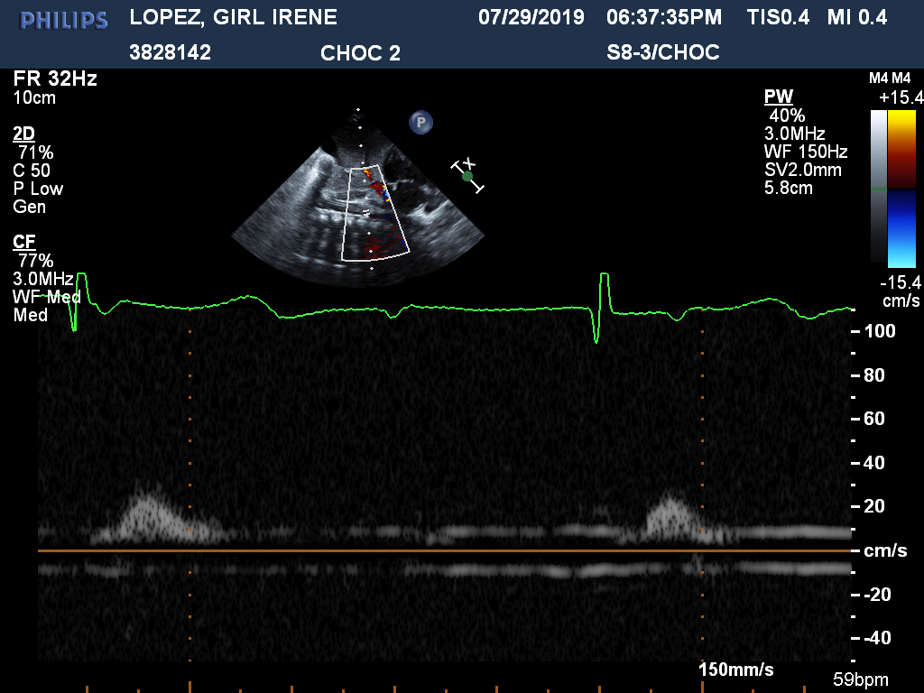
Notes:
Day 1

Slide 6
Notes:
Day 1

Slide 7
Notes:
Day 1

Slide 8
Notes:
Day 1

Slide 12
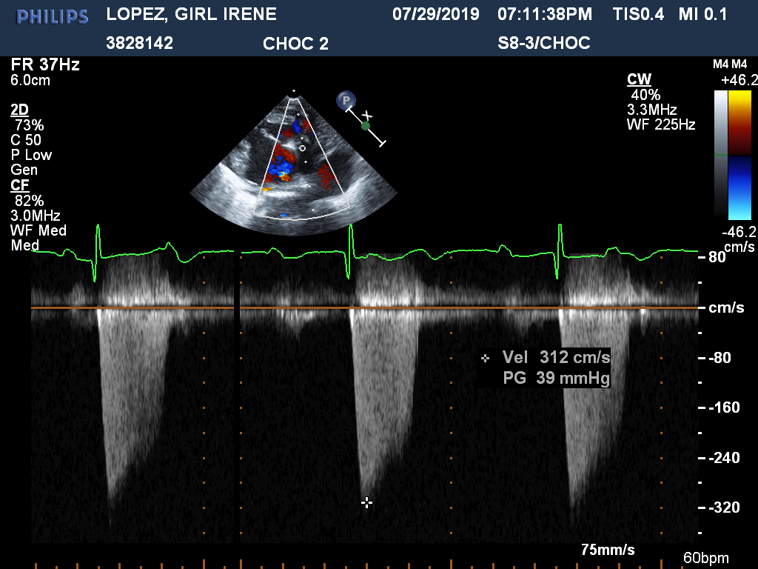

Slide 16
Day Three

Slide 17
Notes:
Day 3 s/p PMI

Slide 18
Notes:
Day 3 s/p PMI

Slide 19
Notes:
Day 3 s/p PMI

Slide 20
Notes:
Day 3 s/p PMI

Slide 21
Notes:
Day 3 s/p PMI

Slide 22
Notes:
Day 3 s/p PMI

Slide 23
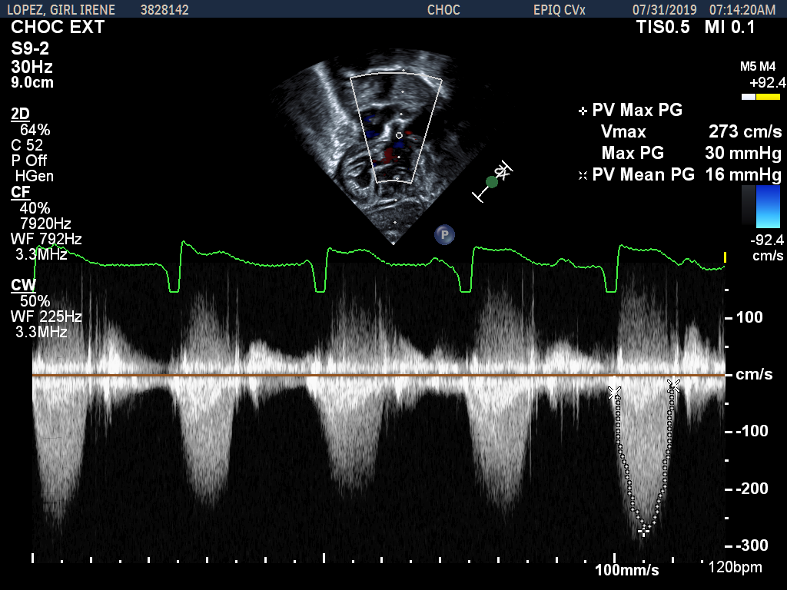
Notes:
Day 3 s/p PMI

Slide 24
Notes:
Day 3 s/p PMI

Slide 25
Notes:
Day 3 s/p PMI

Slide 26
Notes:
Day 3 s/p PMI

Slide 27
Notes:
Day 3 s/p PMI

Slide 28
Notes:
Day 3 s/p PMI

Slide 29
Interventions
Age 1 day: Epicardial VVI pacemaker placement
1 month: Ladd procedure
2 months: Balloon pulmonary valvuloplasty
7 months: Kawashima procedure with PAB
4 years: Heart transplantation

Slide 30
Pediatr Cardiol 2014
From 1995 to 2011, 154 fetuses with heterotaxy syndrome
91 polysplenia syndrome
22 bradycardia (n=13, 59%) or complete AVB (n=8, 36%), or second-degree AVB (n=1, 5%)
15/22 live-born (ETOP 3, SAB 4)
One-year survival 12/19, 63% -- 9 required pacemaker
Predictors of perinatal death: hydrops, ventricular dysfunction, prematurity, and low ventricular rates

Slide 31
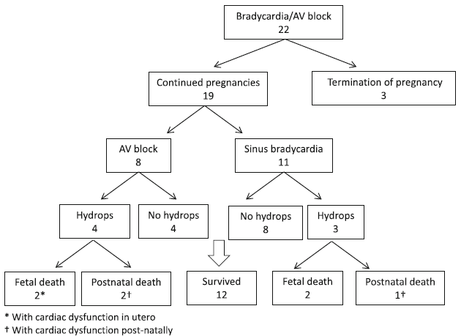

Slide 32
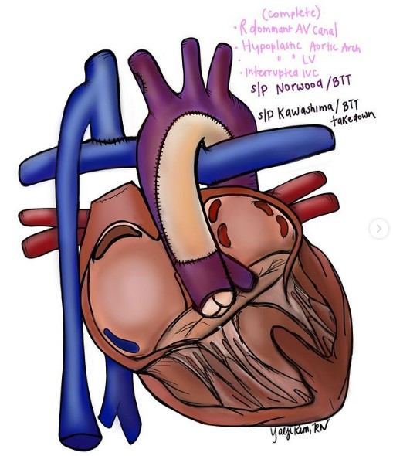
Kawashima Procedure

Slide 33
Heart Lung Circ 2014
15 patients, mean follow-up 40 months
9 NHYA functional class I, 5 NHYA class 2, 1 class 3 (needs Fontan)
Pulmonary AVM rate not known
Ann Pediatr Card 2021
26 patients, mean follow-up 4.8 years
12/26 (46%) developed pulmonary AVM
Fontan in 5/12, axillary AV fistula creation 3/12

Slide 34
2020
2021
Notes:
Day 3 s/p PMI

Slide 35
2022
2023
Notes:
Day 3 s/p PMI

Slide 36
J Heart Lung Transplant
2021
Mortality risk higher in HS patients
One-year survival 77% vs. 85%
Mortality risk mitigated in recent transplant era
Increased risk from both infection and severe rejection

Slide 37
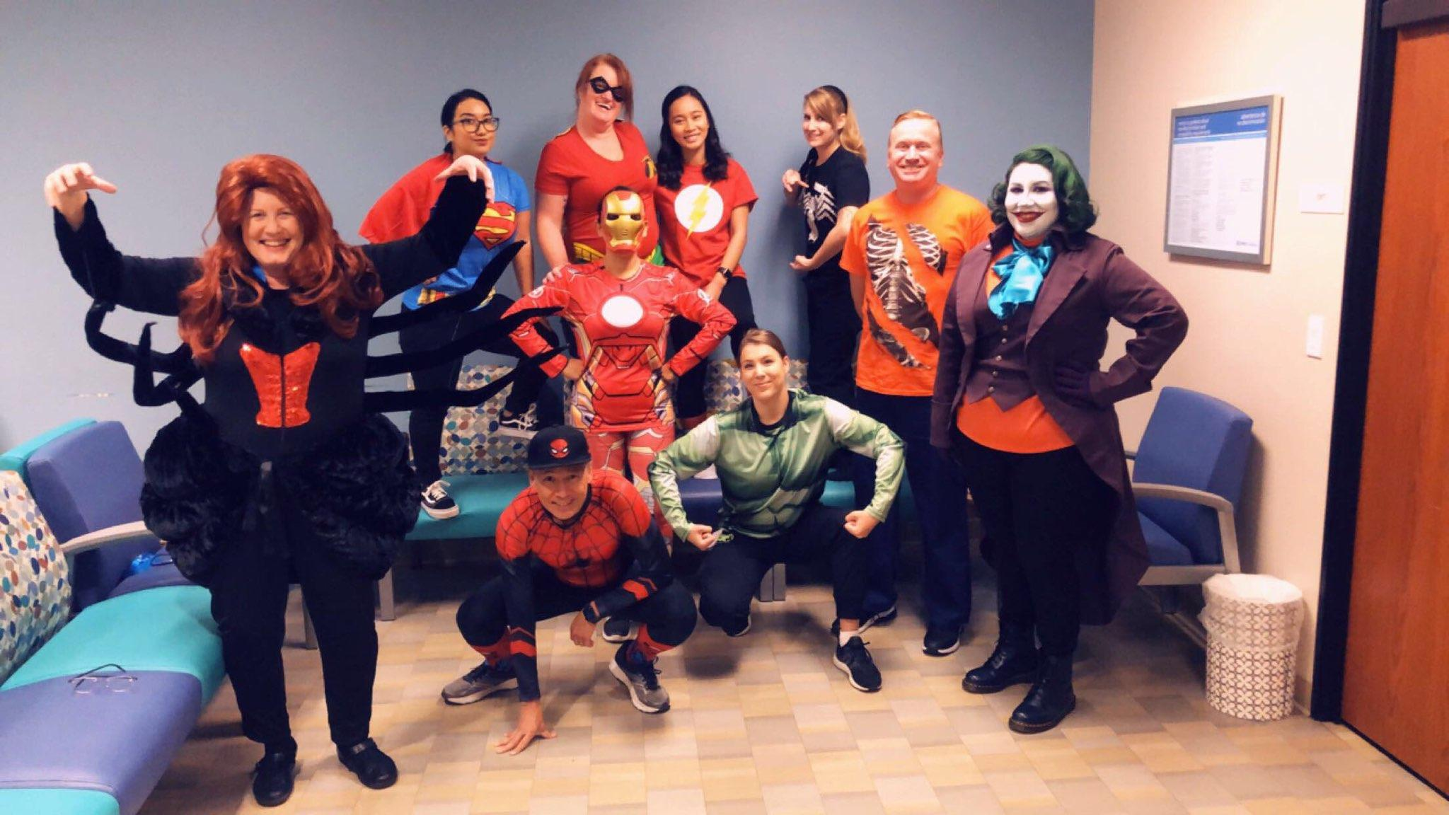
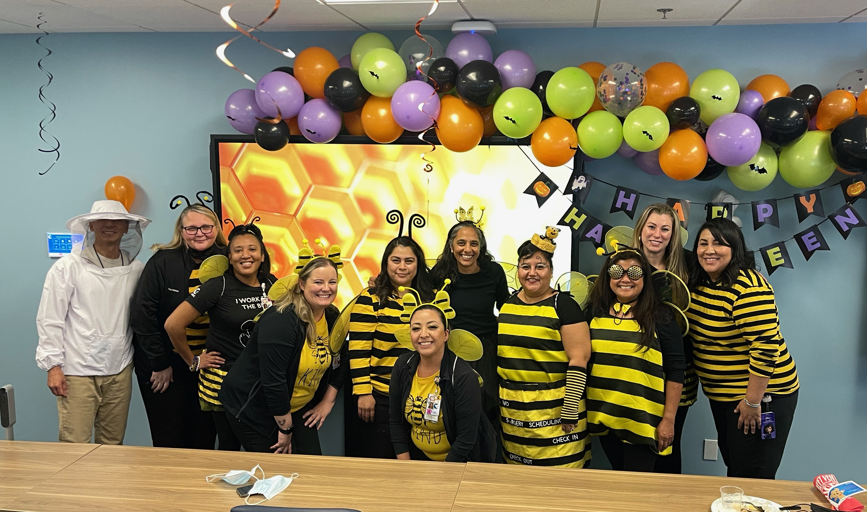
Welcome to OC!

